Slide 1
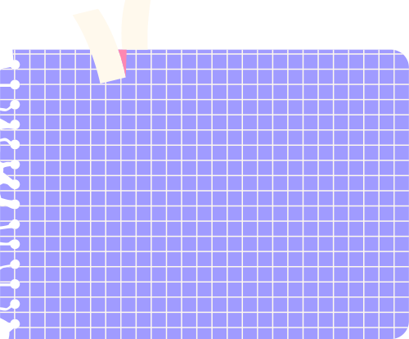










PROJECT
IN TURTLE

Slide 2






ENABLE Turtle
To work with Turtle, it is necessary to enable scripting mode for Turtle in Python IDLE. To do so, kindly follow the instructions as given in PPT T1-Turtle Graphics.

Slide 3
IDENTIFICATION OF COORDINATES
To identify the Coordinate of any point, first move right/left along the X-axis (sleeping line/horizontal line) and then move up/down along the Y-axis (standing/ vertical line).

Slide 4

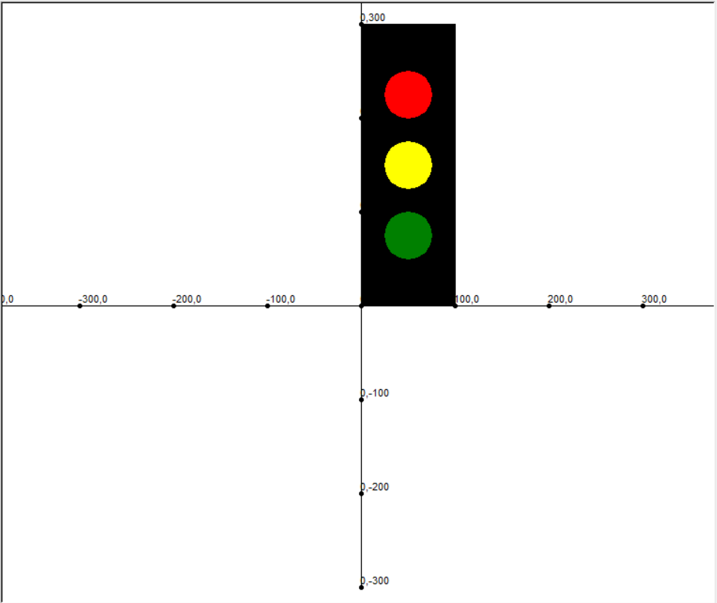
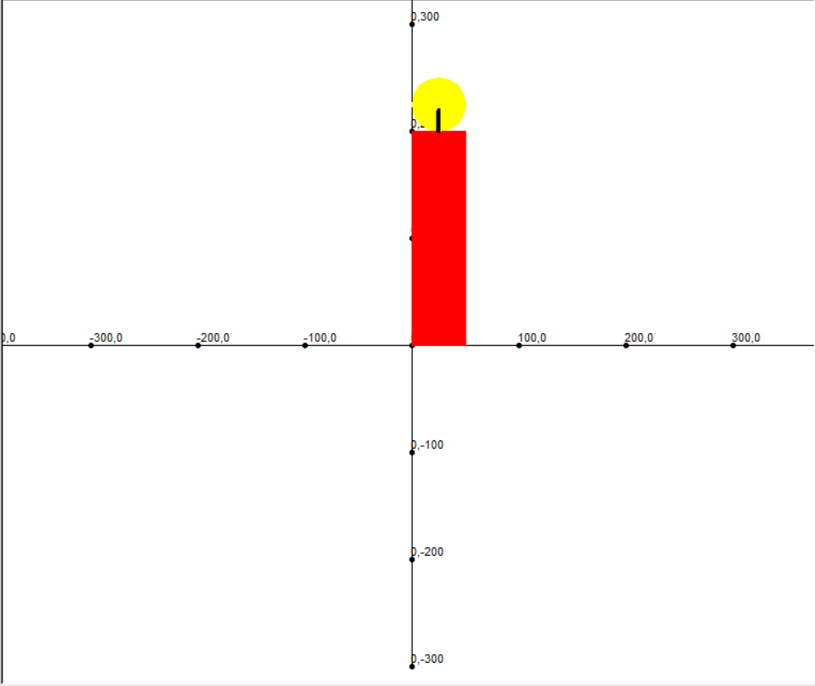

Using the Coordinates Code we can
draw images and even complex drawings

Slide 5



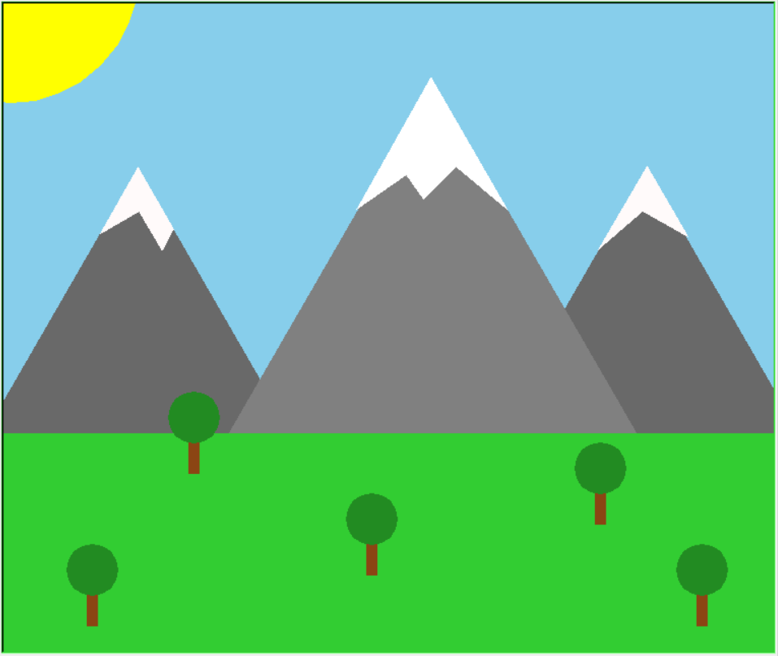
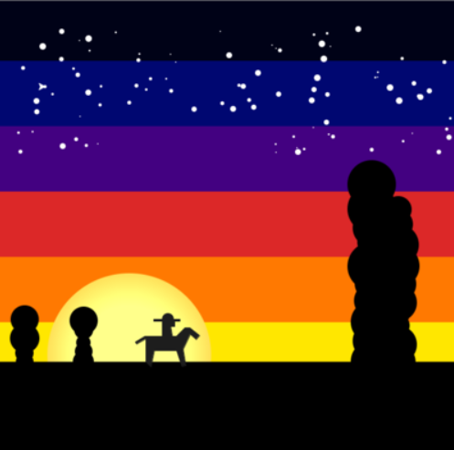
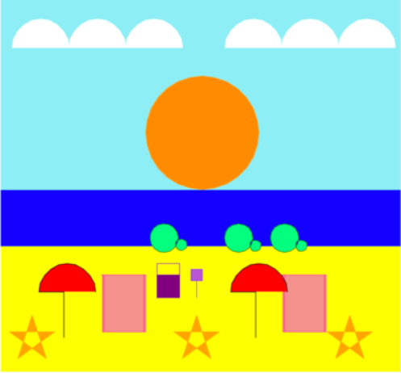
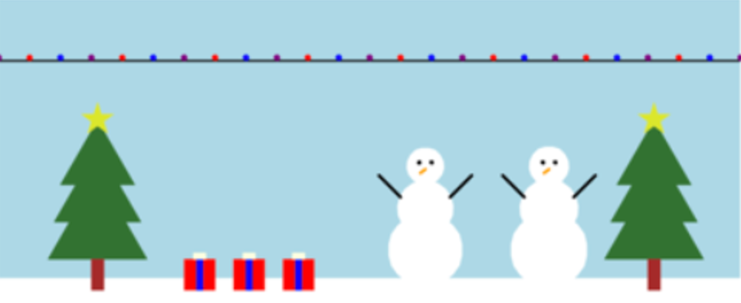
YOU’RE THE ARTIST!!!

Slide 6


HOW TO USE THE “COORDINATES CODE” TO DRAW MULTIPLE ELEMENTS IN ONE SINGLE
TURTLE WINDOW?

Slide 7

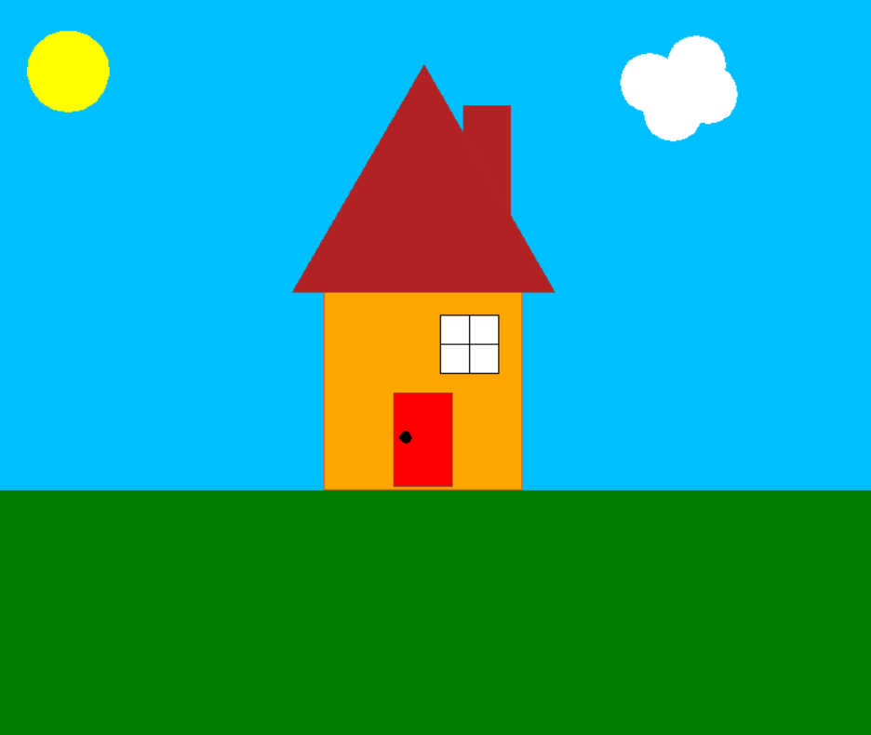
STEP-1
Identify the elements in your drawing.

Slide 8
ELEMENTS IN A
TURTLE DRAWING
In this diagram, grass, sky, sun, cloud, roof of the house, window, chimney, door and its handle are individual elements.

Slide 9
ELEMENTS IN A
TURTLE DRAWING
We need to identify the coordinates of those elements in order to combine them and complete our Turtle Drawing.
We can combine the “Coordinates Code” and goto() function to find out the coordinates.

Slide 10
ELEMENTS IN A
TURTLE DRAWING
The code for this Drawing has been attached. Use the same as a reference for your own creation.

Slide 11
STEP-2
Identify the coordinates of your elements in your drawing.
First copy-paste the COORDINATES CODE. Then, position your elements using your imagination.
Now, use the goto() function and go to the required coordinates to draw your elements.

Slide 12
STEP-2 (Contd.)
Draw one element of your drawing at a time and comment other lines of code to check if it has come out well.
Follow the same for all the individual elements and finally execute the whole code to view the complete drawing.

Slide 13
STEP-3
Finally delete the COORDINATES CODE from your Turtle drawing as it is not needed anymore!

Slide 14
USE THESE IMAGES
AS REFERENCE

Slide 15
USE THESE IMAGES
AS REFERENCE

Slide 16

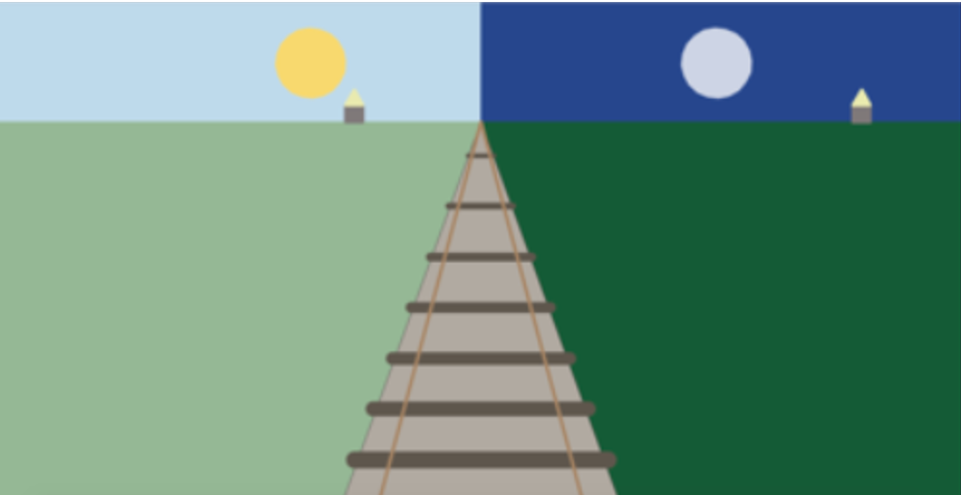

YOUR TURTLE DIAGRAM CAN BE SIMPLE. BUT LET IT BE YOUR ORIGINAL WORK.

Slide 17
WHAT can YOU DO using turtle?
Change background color.
Change pen color.
Change pen size.
Draw different shapes.
Fill in your favorite color.

Slide 18
Present your theme and drawing to everyone in the next class.

Slide 19





You can draw anything you like!
THINK OUTSIDE THE
BOX

Slide 20
HAPPY LEARNING!

